Slide 1


SIMATS ENGINEERING
SAVEETHA INSTITUTE OF MEDICAL AND TECHNICAL SCIENCES
MLA0408 - DEEP LEARNING
AI-Powered Personal Finance Management and Budget Recommendation System Using Deep Learning
Presented by
Nalipi Reddy Rohith(192425115)
G.J.D.Sai Sharan (192425152)
K Giridhar (192425160)
S Syed Abuzar(192425384)
Guided By
Dr. Sudhagar
Professor

Slide 2


INTRODUCTION
Managing personal finances can be challenging due to multiple income sources, expenses, and financial commitments.
Users often struggle to track spending, control unnecessary expenses, and maintain a balanced budget.
Unexpected expenses, changing financial goals, and irregular income can make financial planning difficult.
Our solution:
Develop a AI-Powered Personal Finance Management and Budget Recommendation System Using Deep Learning
Analyze users' income, expenses, and transaction history using deep learning techniques.
Help users achieve better financial planning, improve savings, and make smarter financial decisions.

Slide 3
SDG MAPPING
SDG 1: No Poverty
Supports better financial planning and savings, helping users improve their financial security and reduce the risk of debt.
SDG 8: Decent Work and Economic Growth Promotes responsible financial management, encouraging better budgeting, saving habits, and economic well-being.
SDG 9: Industry, Innovation and Infrastructure Applies Deep Learning and intelligent financial analytics to deliver innovative and personalized budget recommendations.
SDG 12: Responsible Consumption and Production Encourages responsible spending by analyzing user expenses and suggesting optimized budgeting strategies.

Slide 4
LITERATURE REVIEW
Author / Year | Method / Topic | Key Findings | Limitations
J. Smith et al., 2022 | Deep Learning-Based Personal Finance Management | Applied deep learning to analyze spending patterns and predict expenses | Limited personalization for diverse user profiles
A. Kumar et al., 2023 | AI-Powered Budget Recommendation System | Generated personalized budget plans based on transaction history | Performance depends on the quality of financial data
R. Singh et al., 2024 | Expense Prediction Using LSTM Networks | Improved future expense forecasting using time-series analysis | Reduced accuracy with irregular spending behavior
L. Chen et al., 2023 | Intelligent Financial Behavior Analysis | Identified spending habits and detected unusual transactions | High computational requirements for large datasets
M. Sharma et al., 2025 | Smart Personal Finance Assistant Using Deep Learning | Combined expense prediction, budgeting, and financial recommendations | Limited integration with multiple banking and payment platforms

Slide 5
PROBLEM IDENTIFICATION
Managing personal finances has become increasingly challenging due to multiple income sources and daily digital transactions.
Users often struggle to track expenses, control unnecessary spending, and maintain an effective budget.
Existing budgeting applications mainly rely on manual inputs and provide limited personalized financial insights.
Unexpected expenses, irregular income, and changing financial goals make financial planning difficult.
There is no intelligent system that uses deep learning to analyze spending behavior, predict future expenses and provide personalized budget recommendations.

Slide 6
OBJECTIVES
To develop a Deep Learning-Based Smart Personal Finance Management and Budget Recommendation System.
To analyze users' income, expenses, savings, and transaction history using deep learning techniques.
To provide personalized budget recommendations based on individual spending patterns and financial goals.
To predict future expenses and identify unnecessary spending through intelligent financial analysis.
To help users improve savings, manage expenses efficiently, and achieve better financial planning.
To enhance financial decision-making by delivering accurate insights, automated recommendations, and real-time spending analysis.

Slide 7
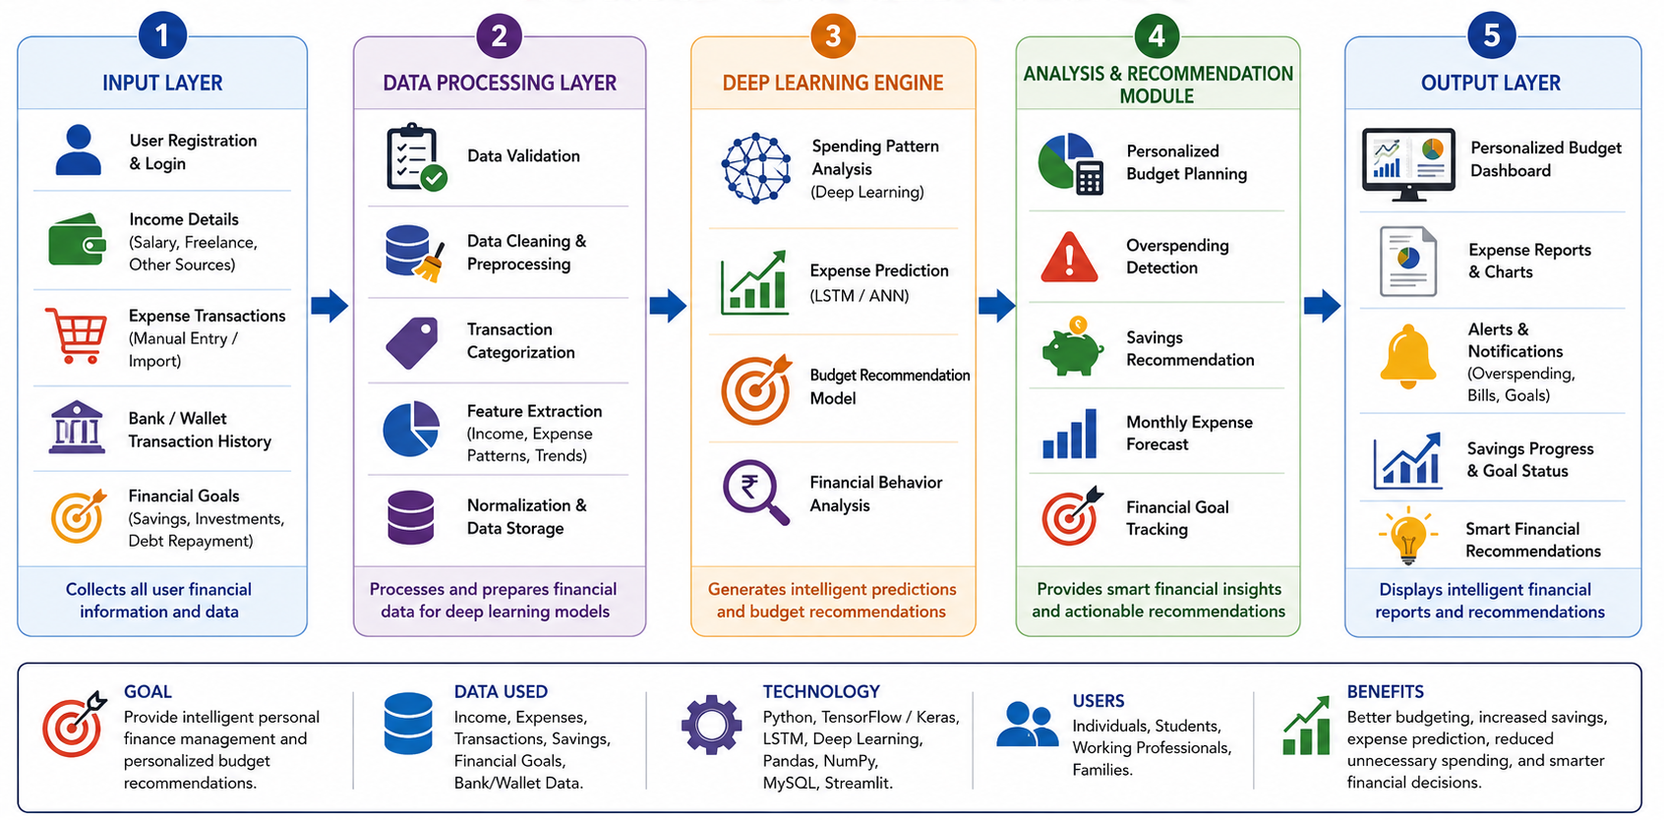
SYSTEM ARCHITECTURE

Slide 8
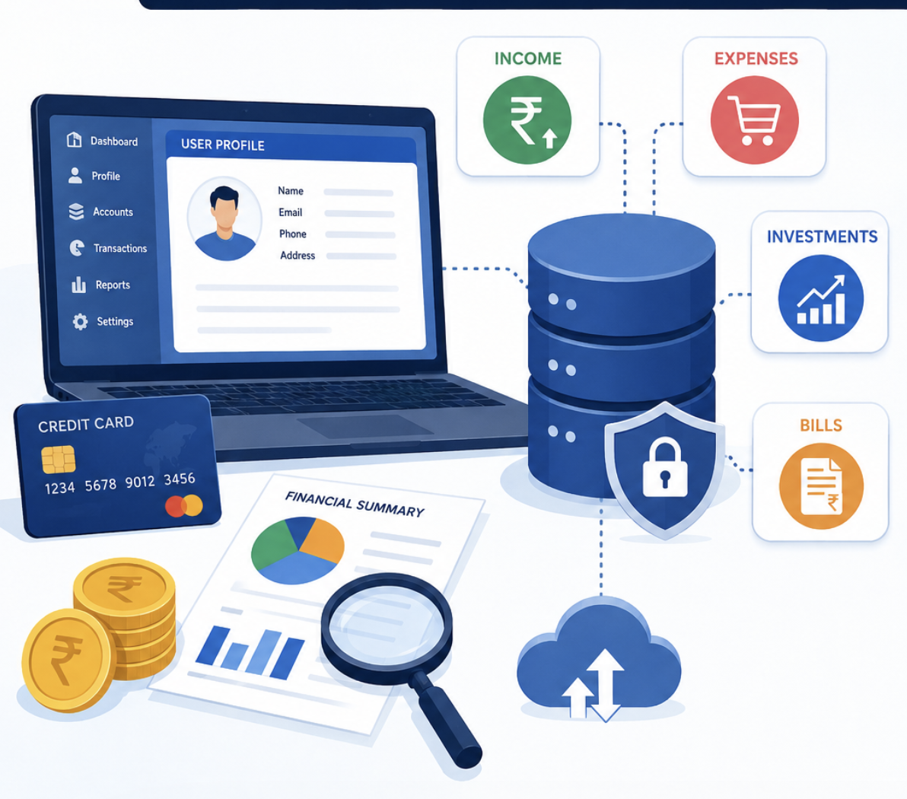
MODULE 1: USER & FINANCIAL DATA MANAGEMENT
Objective: To collect, store, organize, and manage user and financial data for secure, accurate, and personalized financial management.
Key Steps:
Collect user details: profile, income, expenses, savings, and financial goals
Store financial records in a structured database for efficient access and categorize transactions into income, expenses, investments, and bills
Validate and clean financial data to ensure accuracy and consistency
Maintain organized financial information for quick retrieval and analysis

Slide 9
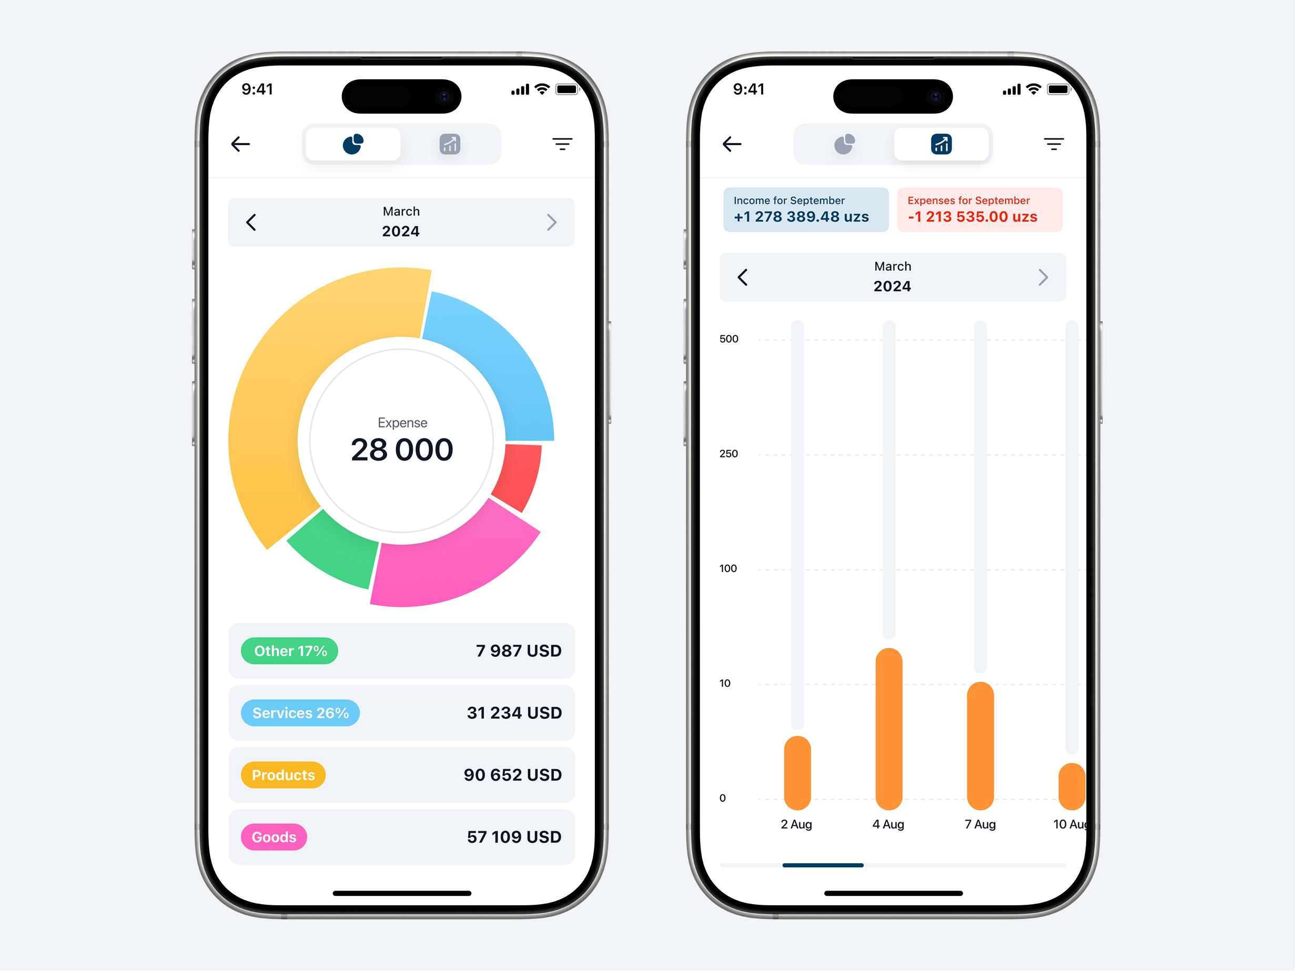
MODULE 2: SMART EXPENSE CLASSIFICATION & ANALYTICS
Objective: To automatically classify financial transactions and analyze spending patterns for better budgeting and financial decision-making.
Key Steps:
Collect and process user transaction data from multiple sources
Automatically classify expenses into categories such as food, transport, shopping, healthcare, and bills
Analyze spending trends using statistical and visual analytics
Detect unusual or excessive spending patterns through intelligent analysis

Slide 10
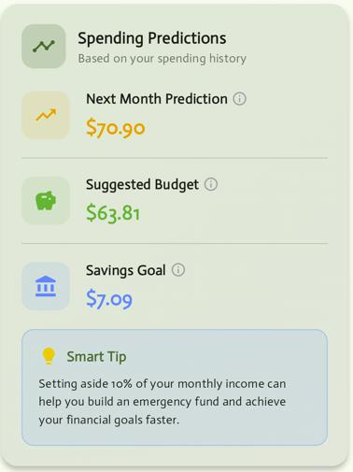
MODULE 3 DEEP LEARNING-BASED BUDGET PREDICTION & RECOMMENDATION
Objective: To predict future expenses and provide personalized budget recommendations using deep learning for effective financial planning.
Key Steps:
Collect historical income, expense, and savings data.
Preprocess and normalize the financial data.
Predict future expenses using the LSTM deep learning model.
Generate personalized budget recommendations based on predictions.
Continuously improve prediction accuracy with new transaction data.

Slide 11
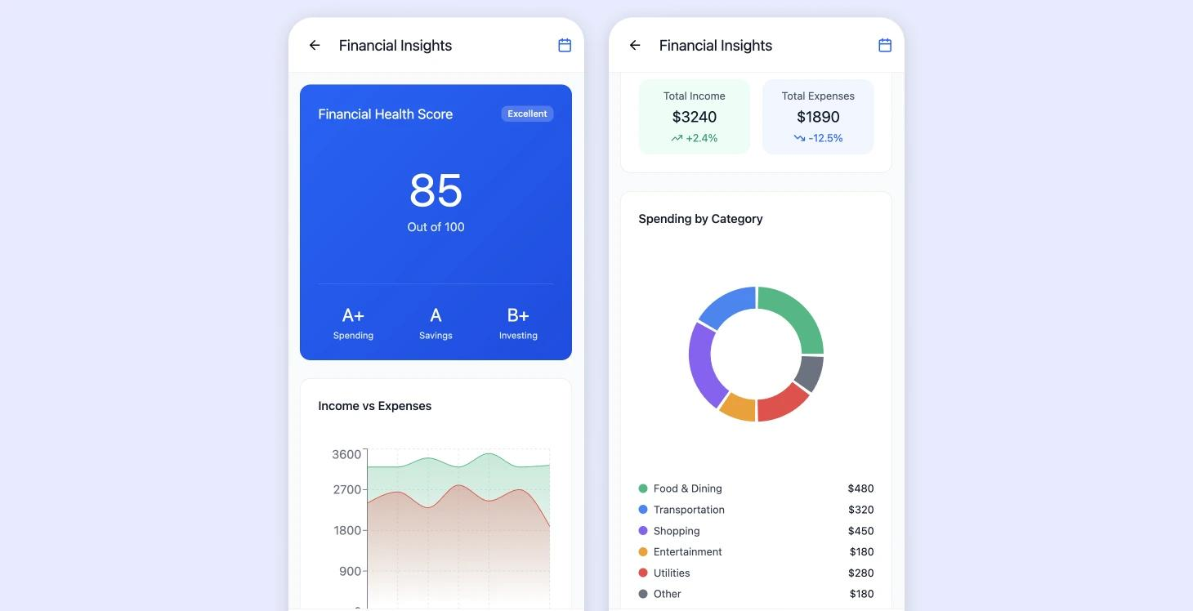
Module 4: Financial Health Monitoring & Reporting
Objective: To monitor users' financial health and generate reports for better financial planning and decision-making.
Key Steps:
Track income, expenses, savings, and investments.
Analyze financial health using key financial indicators.
Detect unusual spending and budget deviations.
Generate visual reports and financial summaries.
Provide insights to improve overall financial well-being.

Slide 12
IMPLEMENTATION

Slide 13
IMPLEMENTATION

Slide 14
OUTPUT

Slide 15
RESULT AND DISCUSSION

Slide 16
CHALLENGES & LIMITATIONS

Slide 17
FUTURE ENHANCEMENTS

Slide 18
CONCLUSION

Slide 19
References

Slide 20
Thank You!

